Slide 1
Capstone Project Forex Prediction Model
Stella Tan

Slide 2
Agenda
01
02
03
04
Problem Statement
Project Workflow
Objective
Data Cleaning
Trading Strategies
Model Results
Neural Networks
Model Improvements
05
Conclusion

Slide 3

Problem Statement
In recent years, there has been a rise of electronic trading, HFT and use of aggregators and algos in FX space. Algorithmic trading uses a computer program that follows a defined set of instructions (an algorithm) to place a trade.
With the availability of historical forex data and the popularity of data science and machine learning, there has been increased interest in setting up algorithmic trading systems.
However the results vary as market conditions hardly stay consistent. The results are as good as the trading strategy and the models used, and herein lies the challenge.

Slide 4

Objectives
To focus on 2 of the most traded pairs GBP/USD and AUD/USD with different characteristics observed from charting. GBP is volatile with price gaps while AUD is very trendy.
Data visualisation – plot of closing prices and technical indicators like moving average, RSI, MACD, with signals
To use LSTM model (a recurrent neural network ideal for time series) for prediction of forex prices
To test out different trading strategies and generate signals
To do forward testing on model

Slide 5
Project Workflow
Data Preparation Data Cleaning
Data Exploration
Features
Visualisation
Model Results
Testing
Evaluation
Objective
Trading Strategies
Models
1min data from FXCMPY url over 2020, copied to csv. 355k rows.
Take the mid of bid/ask, format date, drop na values.
Formulate trading strategies based on our features using classification.
Plot the trading strategies with signals for a first insight into how the strategies are working.
Use a LSTM (a recurrent neural network) to predict
Use Tensorflow Keras
Display model results
Improvisation
Backward/forward testing on the model
Other than the close (price), features included moving average, relative strength index, MACD and stochastic slow oscillator.
Plot close vs technical indicators

Slide 6
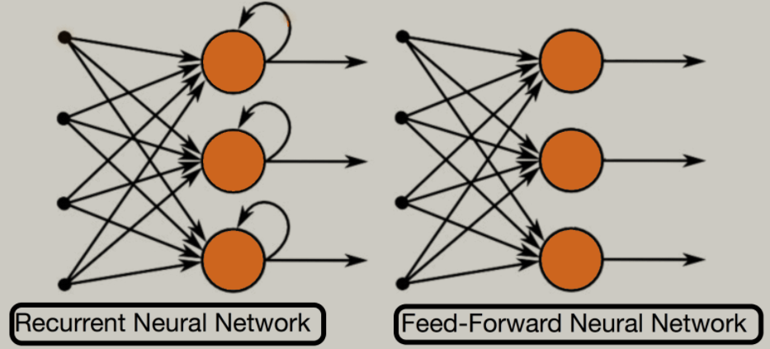
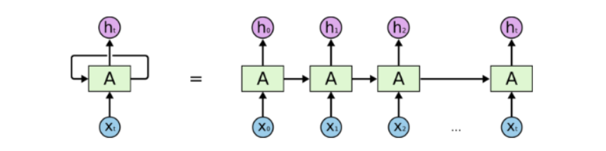
Neural Networks – Recurrent Neural Network (RNN)
While the Feedforward Neural Network takes decisions based on only the current input, the RNN takes decisions based on current and previous inputs.
RNN performs the same function for every input of data while the output of the current input depends on the previous one computation. After producing the output, it is copied and sent back into the recurrent network. For making a decision, it considers the current input and the output that it has learned from the previous input.
First, it takes the X(0) from the sequence of input and then it outputs h(0) which together with X(1) is the input for the next step. So, the h(0) and X(1) is the input for the next step. Similarly, h(1) from the next is the input with X(2) for the next step and so on. The network keeps remembering the context while training.

Slide 7
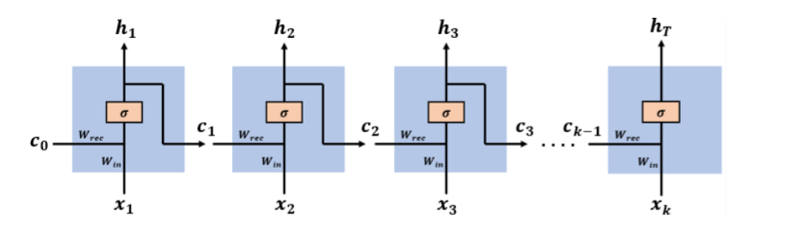
Neural Networks - RNN
The network has an input sequence of vectors [x(1), x(2),…, x(k)], at each time step.
Past information and learned knowledge is encoded in the network state vectors [c(1), c(2),…, c(k-1)]
The input vector x(t) and the state vector c(t-1) are concatenated to comprise the complete input vector at time step t, [c(t-1), x(t)] .
The network has two weight matrices: Wrec and Win connecting c(t-1) and x(t), the two parts of the input vector [c(t-1), x(t)], to the hidden layer.
The network outputs a single vector at the last time step

Slide 8
Neural Networks – RNN and LSTM
Disadvantages of Recurrent Neural Network
Gradient vanishing and exploding problems.
Training an RNN is a very difficult task.
RNNs suffer from the problem of vanishing gradients, which hampers learning of long data sequences. The gradients carry information used in the RNN parameter update and when the gradient becomes smaller and smaller, the parameter updates become insignificant which means no real learning is done.
What is Long Short Term Memory (LSTM)?
Long Short-Term Memory (LSTM) networks are a modified version of recurrent neural networks, which makes it easier to remember past data in memory. The vanishing gradient problem of RNN is resolved here throught the use of gates. LSTM is well-suited to classify, process and predict time series.
Applications of LSTM include: time series prediction, speech/voice recognition, handwriting recognition.

Slide 9
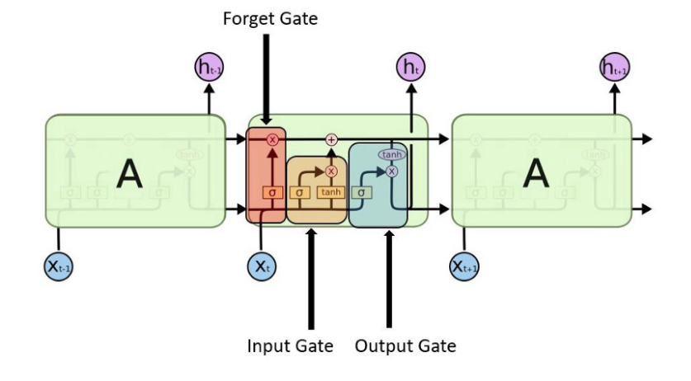
Neural Networks - LSTM
In an LSTM network, three gates are present:
Input gate — discover which value from input should be used to modify the memory. Sigmoid function decides which values to let through and tanh function gives weightage to the values which are passed deciding their level of importance ranging from-1 to 1.
Forget gate — discover what details to be discarded from the block. It is decided by the sigmoid function- it looks at the previous state(ht-1) and the content input(Xt) and outputs a number between 0(omit this)and 1(keep this) for each number in the cell state Ct−1.
Output gate — the input and the memory of the block is used to decide the output. Sigmoid function decides which values to let through and tanh function gives weightage to the values

Slide 10
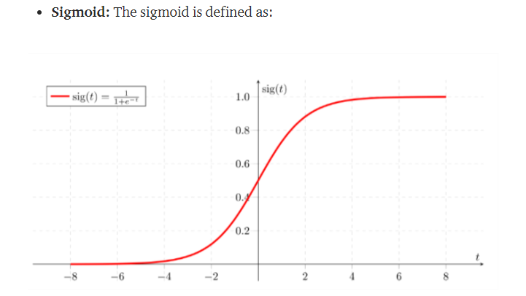
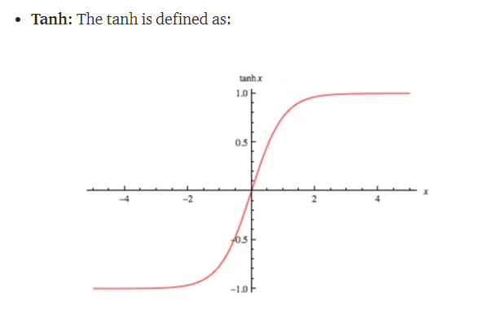
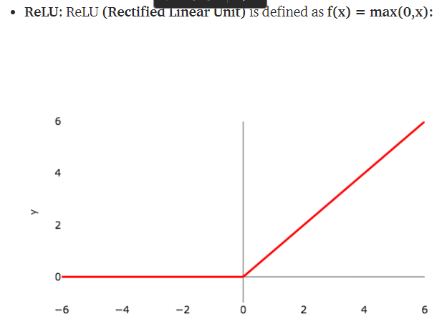
Activation Functions
A function that is added into an artificial neural network in order to help the network learn complex patterns in the data.
It takes in the output signal from the previous cell and converts it into some form that can be taken as input to the next cell.
Sigmoid: generally used for binary classification problems.
Softmax: a more generalised form of the sigmoid. It is used in multi-class classification problems. Similar to sigmoid, it produces values in the range of 0–1 therefore it is used as the final layer in classification models. Softmax() will give the probability distribution which means all output will sum to 1. While, sigmoid() will make sure the output value of neuron is between 0 to 1.
ReLu: widely used, easy to compute and does not saturate and does not cause the vanishing gradient problem. Since the output is zero for all negative inputs. It causes some nodes to completely die and not learn anything.
Another problem is of exploding the activations which leads to unusable nodes.

Slide 11
HOW MANY MODELS DID I END UP WITH?
Classifier
Regressor
Forward Step Regressor
Run forex price”close” versus strategy signals
So what was the problem?
- Same output for all rows
- Very imbalanced data
- Hyperparamter selection
Run forex price”close” versus SMA,(only for GBP)
So what was the problem?
- Need many epochs to get better result.
- Hyperparamter selection
Use first 60 readings to predict 60th value, then next 2-61st reading to predict 61st value and so on.
Con: Takes a long time to run. 8-10 hours for 30 epochs.

Slide 12
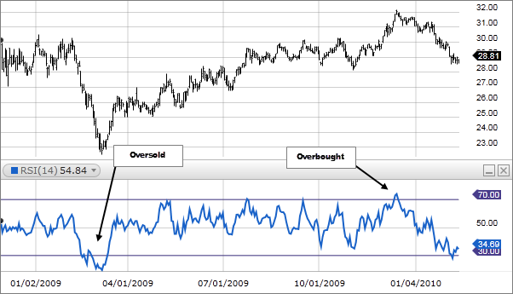
Features
A simple moving average (SMA) calculates the average of a range of closing prices, by the number of periods in that range. It can be used to determine if an asset price will continue or if it will reverse a bull or bear trend.
The relative strength index (RSI) is a momentum indicator used in technical analysis that measures the magnitude of recent price changes. The RSI is displayed as an oscillator, uses 14 periods in calculation and can have a reading from 0 to 100. It signals overbought or oversold price momentum. An asset is usually considered overbought when the RSI is above 70% and oversold when it is below 30%.

Slide 13
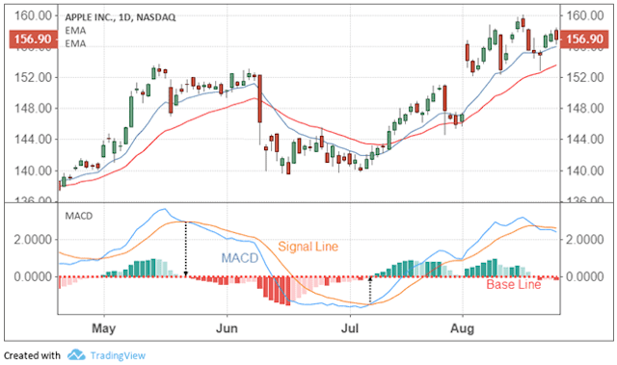
Features
MACD is the 12-day Exponential Moving Average (EMA) less the 26-day EMA. Closing prices are used to form the MACD's moving averages. A 9-day EMA of MACD is plotted along side to act as a signal line to identify turns in the indicator. The MACD-Histogram represents the difference between MACD and its 9-day EMA, the signal line.
MACD: (12-day EMA - 26-day EMA)
Signal Line: 9-day EMA of MACD
MACD Histogram: MACD - Signal Line
The number of periods can be changed according to preference

Slide 14
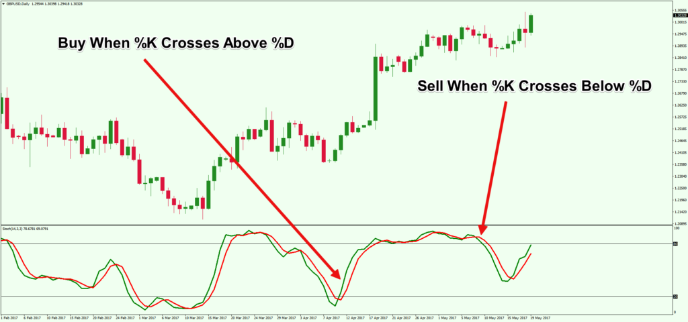
Features
The Slow Stochastic Oscillator is a momentum indicator that shows the location of the close relative to the high-low range over a set number of periods. The indicator can range from 0 to 100.
Two lines are graphed, the slow oscillating %K and a moving average of %K, commonly referred to as %D. Generally, the area above 80 indicates an overbought region, while the area below 20 is considered an oversold region. A crossover signal occurs when the two lines cross in the overbought or oversold region. A sell signal occurs when a decreasing %K line crosses below the %D line in the overbought region. Conversely, a buy signal occurs when an increasing %K line crosses above the %D line in the oversold region.
Typically combined with RSI or MACD

Slide 15
Trading Strategies
Previous Close
Moving Average
Assign a signal value of 1 if current close > previous close and 0 otherwise
Signal to buy if SMA20 is above SMA50 and close price sits above SMA100
Moving Average + RSI
Momentum Strategy
Signal to buy if moving average condition met and RSI signal is met .
RSI buy signal occurs when RSI sits below 50 and turns up.
Signal to buy if MACD, Stochastic Slow and RSI signal is met
Stochastic buy signal occurs when k value sits below 25 and k cuts above d line
MACD buy signal occurs when MACD crosses signal line from below.

Slide 16
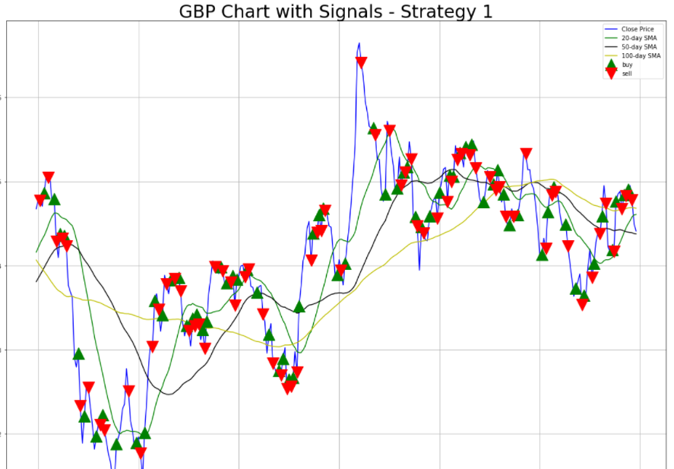
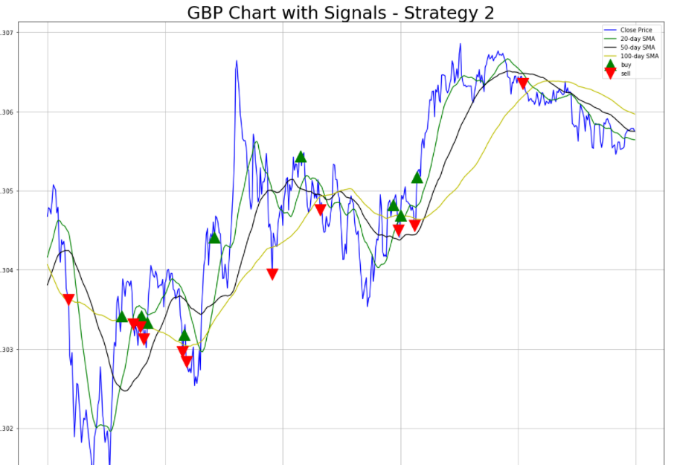
Visualisation

Slide 17
THE LSTM MODEL AND
MODEL RESULTS

Slide 18
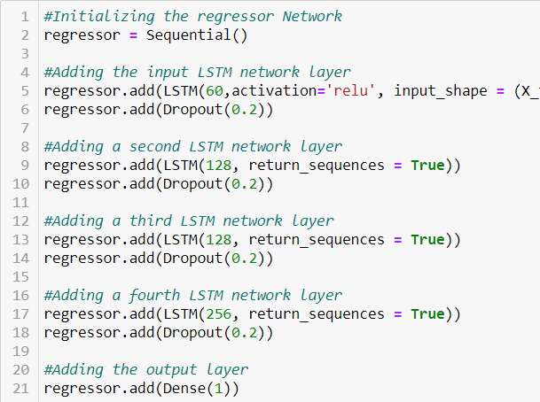
What kind of parameters do we consider in LSTM
Number of LSTM layers and units
Creating a layer of LSTM memory units allows you to specify the number of memory units within the layer.
Activation functions
Output Layer – Dense with number of output variables
Dropout layer – a regularization method where input and recurrent connections to LSTM units are probabilistically excluded from activation and weight updates while training a network. Reduces overfitting and improving model performance.
What Is a Sample?
A sample is a single row of data.
What Is a Batch?
The batch size is a hyperparameter that defines the number of samples to work through before updating the internal model parameters.
What Is an Epoch?
The number of epochs is a hyperparameter that defines the number times that the learning algorithm will work through the entire training dataset. One epoch means that each sample in the training dataset has had an opportunity to update the internal model parameters.

Slide 19
Model Results –Classifier with Strategy
Strategy | Number of LSTM layer | LSTM units | Activation Function | Input Shape | Sequences | Output layer, unit | Optimiser | Learning Rate | Epoch | Metric | Results | Winnning Trades
GBP Previous Close | 2 | 12 24 | relu | (X_train.shape[1], 1) | TRUE | 1 | Adam | 1.00E-06 | 20 | accuracy | [1.04493248462677, 0.4926021695137024] | 0.49%
Tune the weights |  |  |  |  |  |  |  |  |  |  |  | 0.25%
GBP Previous Close | 2 | 12 24 | relu | (X_train.shape[1], 1) | TRUE | 1, Softmax | Adam | 1.00E-06 | 20 | accuracy | [1.0459107160568237, 0.4917723834514618] | 0.49%
Tune the weights |  |  |  |  |  |  |  |  |  |  | [1.1037282943725586, 0.25241202116012573] | 0.25%
GBP Previous Close | 2 | 24 48 | relu | (X_train.shape[1], 1) | TRUE | 1, Softmax | Adam | 1.00E-06 | 40 | accuracy | [1.046128511428833, 0.4905347228050232] | 0.49%
Strategy 2 – Moving Average produced 0.96% accuracy but that is because more than 90% of the data set was in the “Hold’” class.
Some observations that the model did not learn well:
The run time per epoch was 3-4ms per step as compared to 70ms for one of the simple regressor models
The accuracy metric did not improve after the first few epochs
The model predicted mostly the Hold labels upon testing.

Slide 20
Model Results –Classifier with Strategy
I stopped running the model after Strategy 2 and decided to do away with preset strategies and let LSTM find a relationship based on the raw data set.
So what went wrong?
We already worked out some strategies based on certain conditions and generated some signals. Could the LSTM learn anything new? Looked to me like model wasn’t learning any new patterns.
Imbalanced data especially with more complex strategies which affected predictions
On further checking, we discovered that most of the winning trades ended up in the ‘Hold’ class – we would not want that to happen for a trading model!
We ran 2 other LSTM models on the dataset – lets have a look in the next slide.

Slide 21
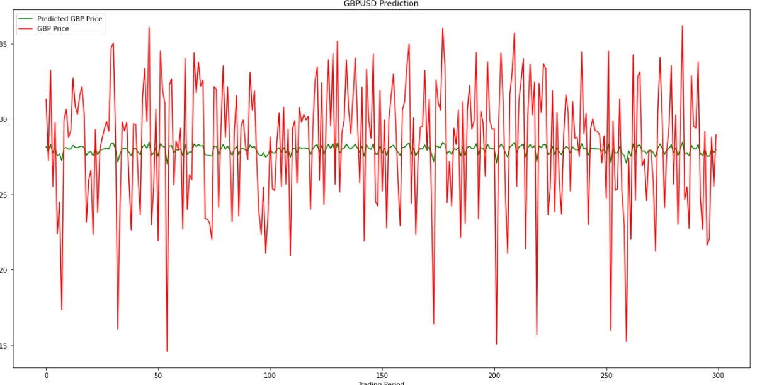
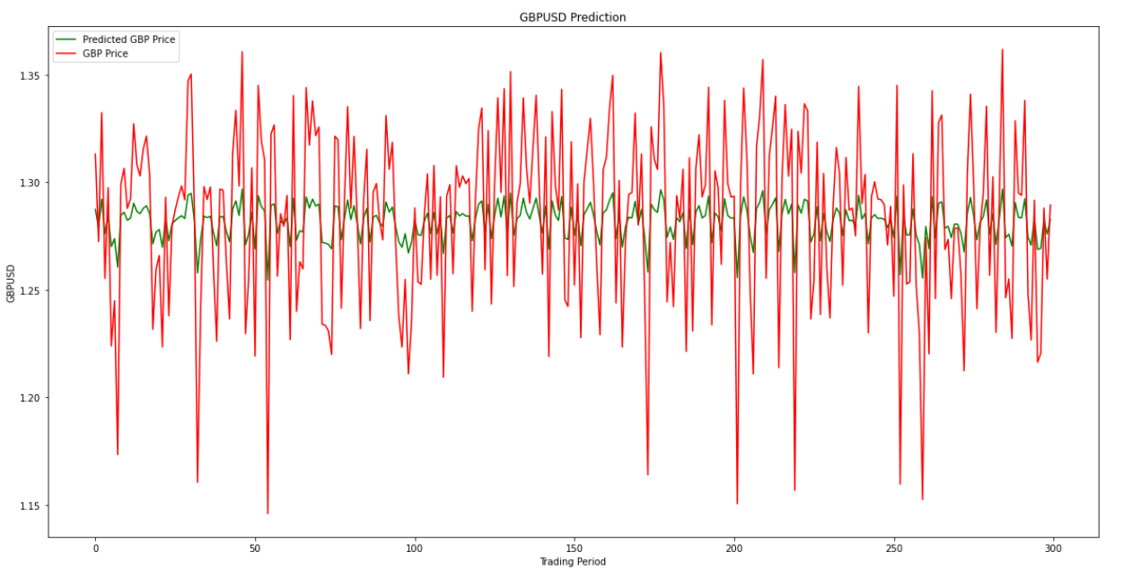
Model Results –Regressor on GBPUSD vs SMA50
 | Number of LSTM layer | LSTM units | Activation Function | Input Shape | Sequences | Output layer, unit | Optimiser | Learning Rate | Loss | Metric | Epochs | Results
1 | 3 | 12 24 24 | Not specified | (X_train.shape[1], 1) | TRUE | 1 | Adam | 1.00E-06 | MSE | 0.005 | 35 | Poor Prediction
2 | 3 | 60 60 60 | relu | (X_train.shape[1], 1) | TRUE | 1 | Adam | 1.00E-06 | MSE | 0.0024 | 100 | Poor Prediction
3 | 4 | 60 128 256 256 | relu | (X_train.shape[1], 1) | TRUE | 1 | Adam | 1.00E-06 | MSE | 4.10E-06 | 200 | Decent Prediction
Simulation 1 – Sample chart of 300 periods
Simulation 2 - Sample chart of 300 periods
Note: Simulation 1 is not found in script as I over ran it with Simulation 2

Slide 22
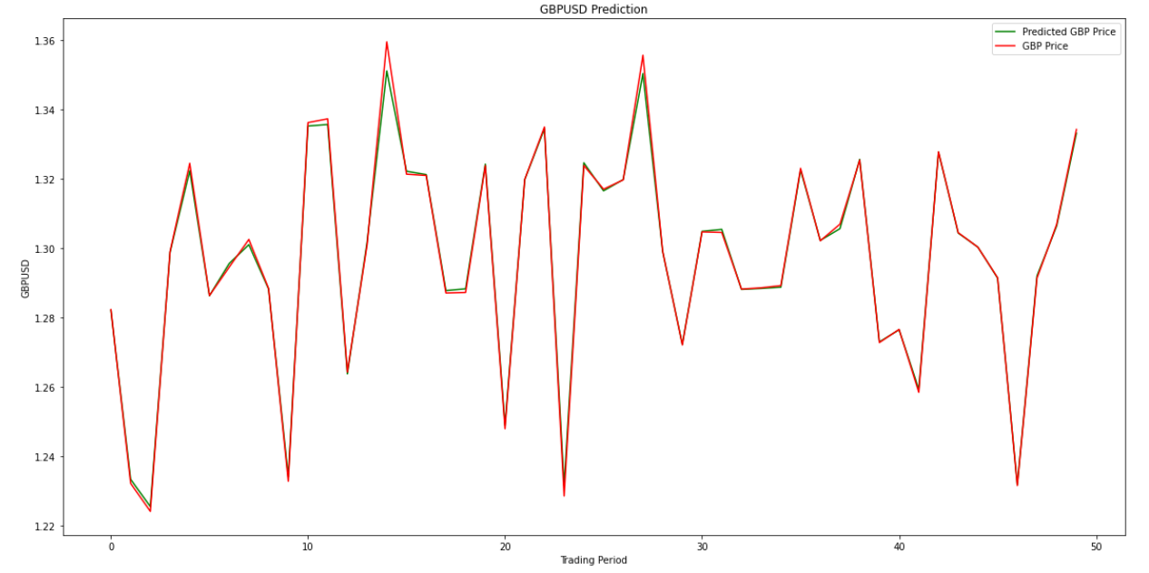

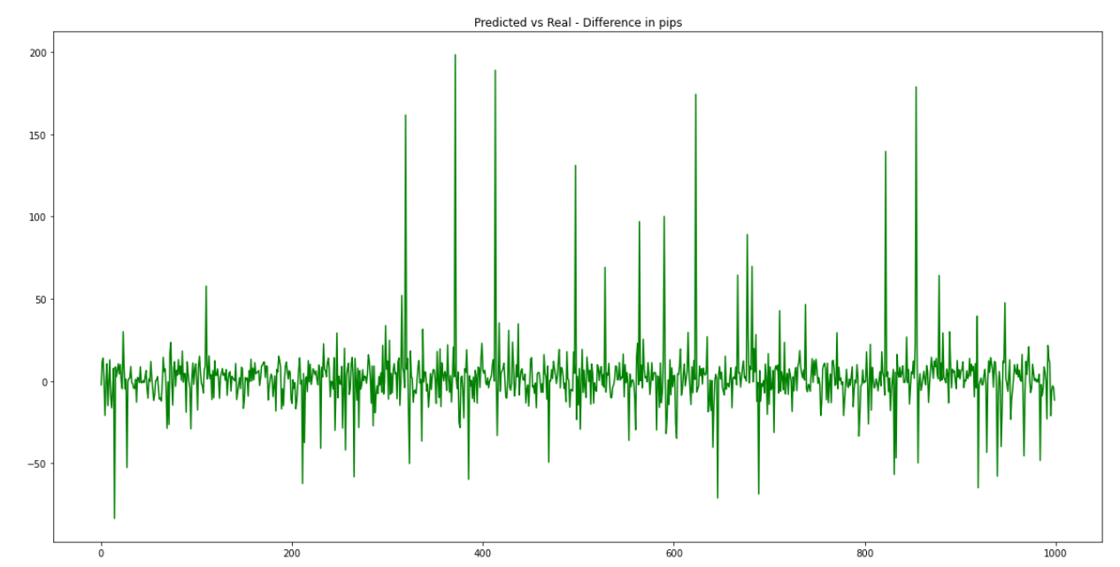
Simulation 3 - 200 epochs and increased layers
Chart showing predicted vs real values for 50 periods. Predictions are pretty decent.
2nd chart showing differences between predicted and real in pips, which are mostly within 30-40pips.
One key reason why a model of SMA50 vs Close does well is because of the high correlation between them.
Look to reduce some of the outliers
More epochs isn’t always better – observe the contribution to model metrics.

Slide 23
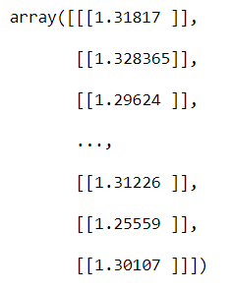
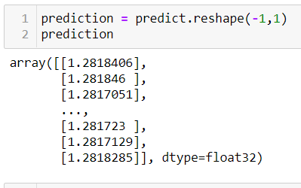

Model Results –Regressor on GBPUSD vs RSI
Actual:
Predicted
RSI does not have a strong correlation with price at all
This result also reflects reality in terms of how RSI is used

Slide 24
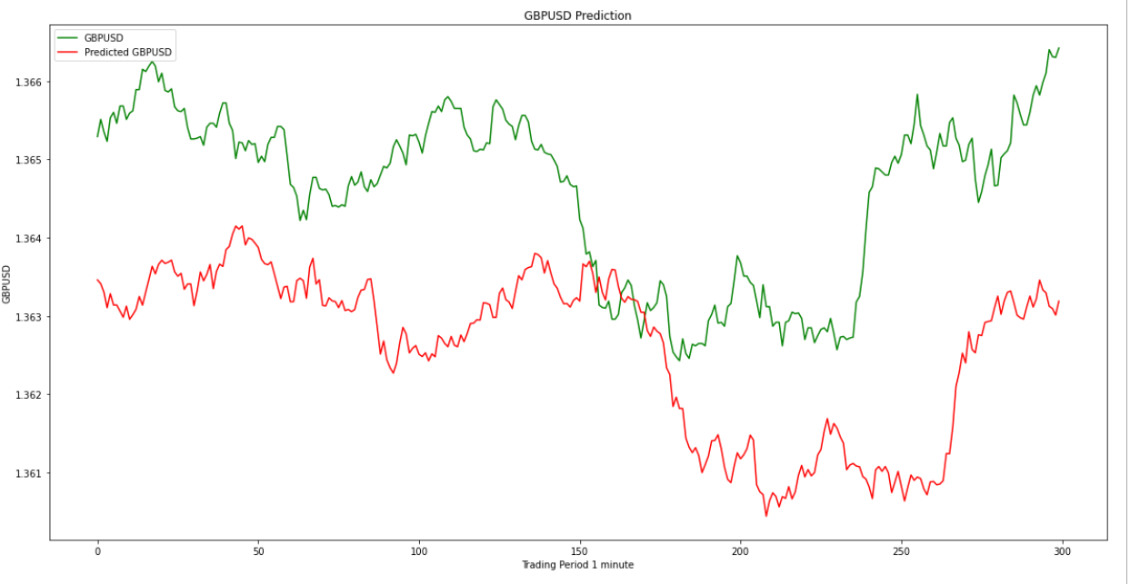
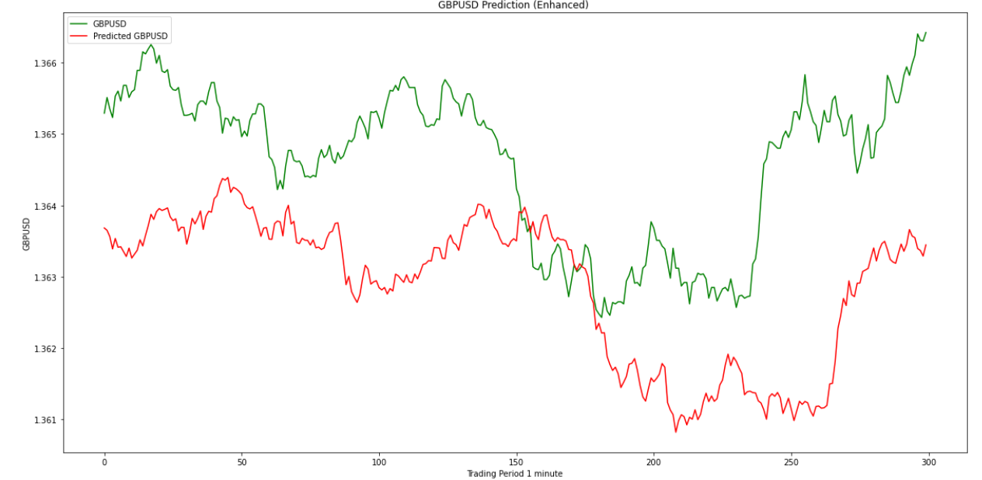
Model Results – Forward Step Regressor for GBP
Simulation | Number of layers | LSTM units | Activation Function | Input Shape | Sequences | Output layer, unit | Optimiser | Learning Rate | Epoch | RESULTS
1 | 3 | 50 50 50 | Not specified | (X_train.shape[1], 1) | TRUE | 1 | Adam | Auto | 15 | loss = 0.00021653
2 | 3 | 12 12 24 | Not specified | (X_train.shape[1], 1) | TRUE | 1 | Adam | 1.00E-05 | 20 | loss = 0.00054671
3 | 3 | 60 60 60 | Not specified | (X_train.shape[1], 1) | TRUE | 1 | Adam | 1.00E-05 | 30 | loss = 0.000211
Results of forward testing using new data set
Simulation 2 – Sample chart of 300 periods
Simulation 3 – Closed the distance between 2 lines

Slide 25
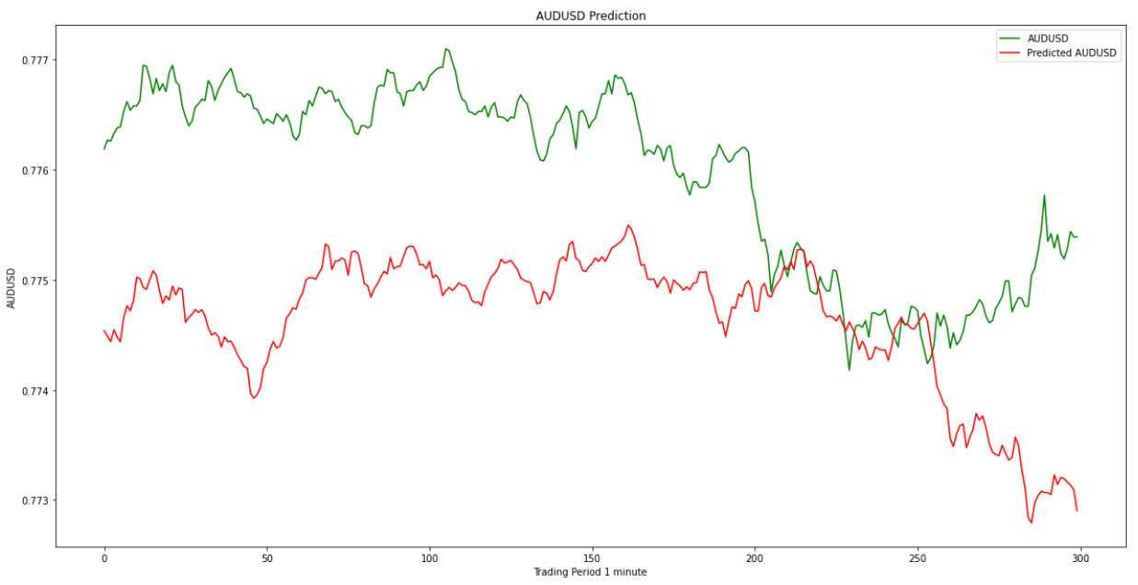
Model Results – Forward Step Regressor for AUD
Results of forward testing using new data set
We used the same parameters as Simulation 3 under GBP since it produced better results, with 3 layers of 60 units, 30 epochs and a learning rate of 1e-05.
Sample chart of 300 time periods
Decent predictions generated from the model, with maximum of 30-40pips divergence from real values based on this 300 time periods.
MSE was about the same at 0.0002+ for GBP and AUD models

Slide 26
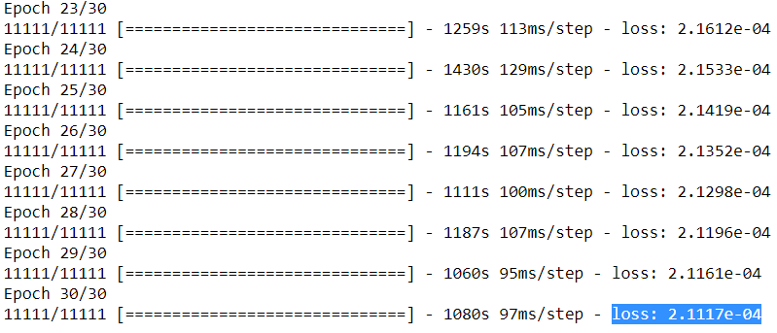
Best Model – LSTM Forward Step Regressor
60 units, 3 lstm layers, 30 epochs
Forward testing on new data set which was abt 10% of training set yielded encouraging results
Takes a long time to run 30 epochs given X is a list of 60 timestamps for each y. About 8-10 hours.
Can attempt more epochs or more layers, as loss is still dropping at 25-30 epochs

Slide 27
Challenges
Time required to formulate the strategies
Coding the strategies and coming up with the classifications
Understanding RNNs and LSTM concepts
Inputs for LSTM – dimensions
Hyperparameter Setting - no optimisation algo to run
Deciphering the predictions in a logical manner. Troubleshooting when issues occur
Imbalanced Data
Is LSTM the best model to use?

Slide 28
Next steps….
Use a machine learning model instead of LSTM for the Classifier case, where I already formulated my strategies.
Improve further the forward step regressor by testing out layers, epochs and learning rate

Slide 29

https://github.com/Ste11a-star/FX-LSTM

